Slide 1
Geometric Symbols

Slide 2
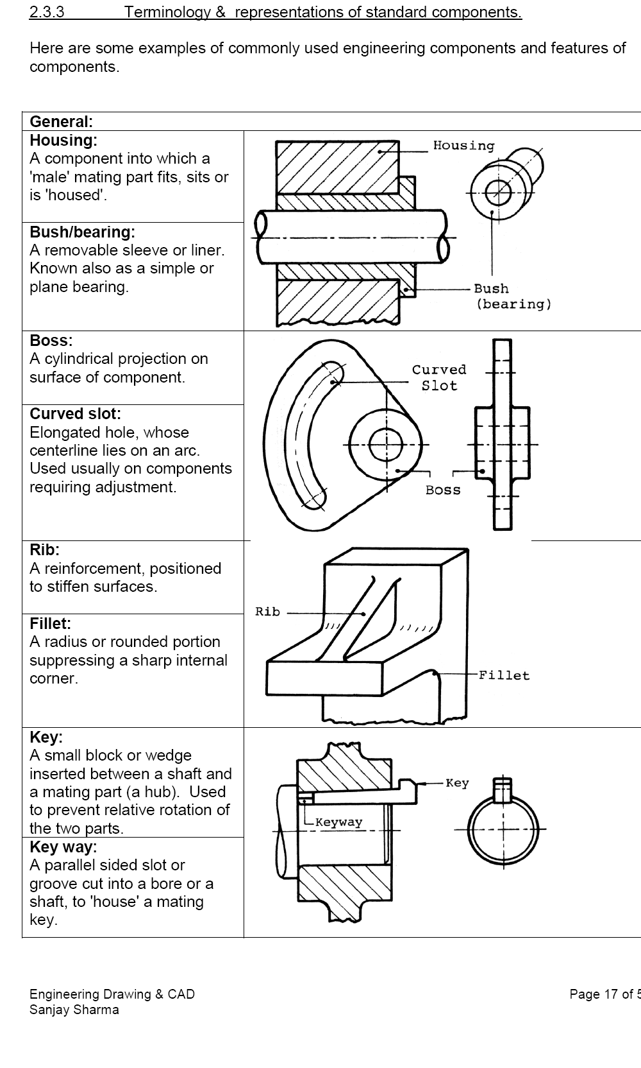

Slide 3
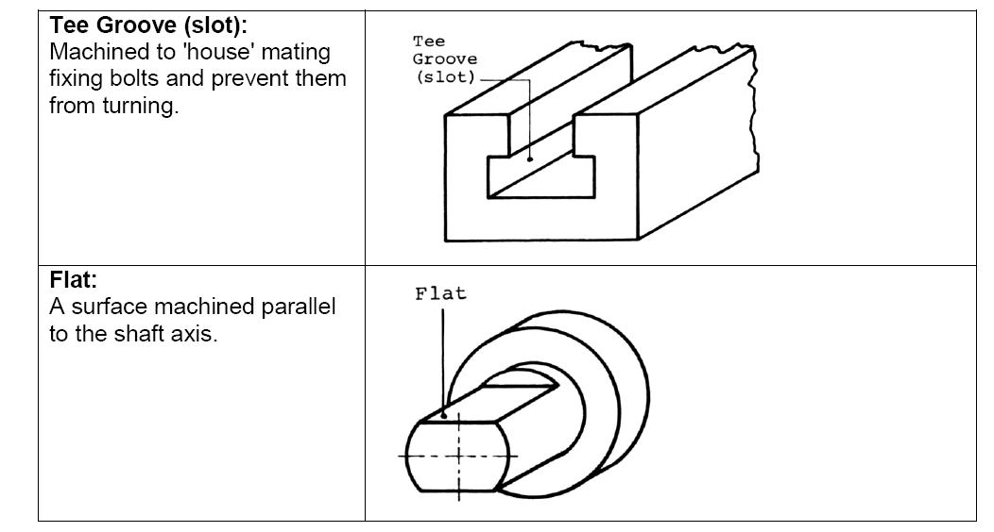

Slide 4
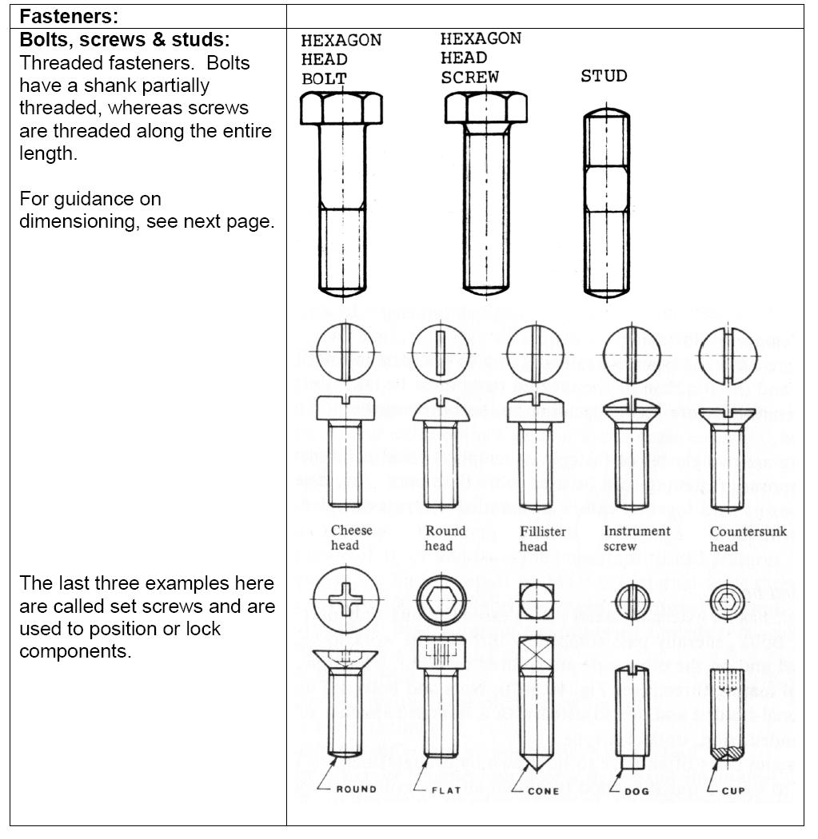

Slide 5
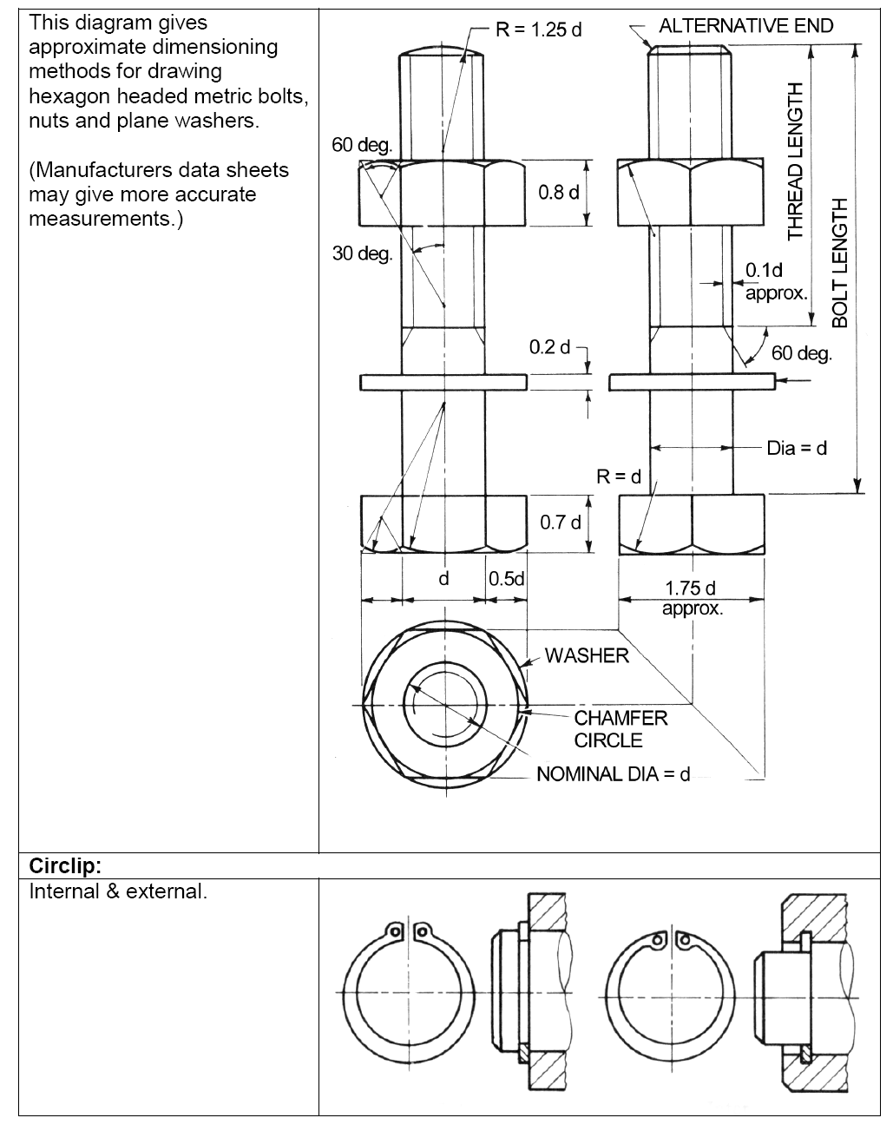

Slide 6
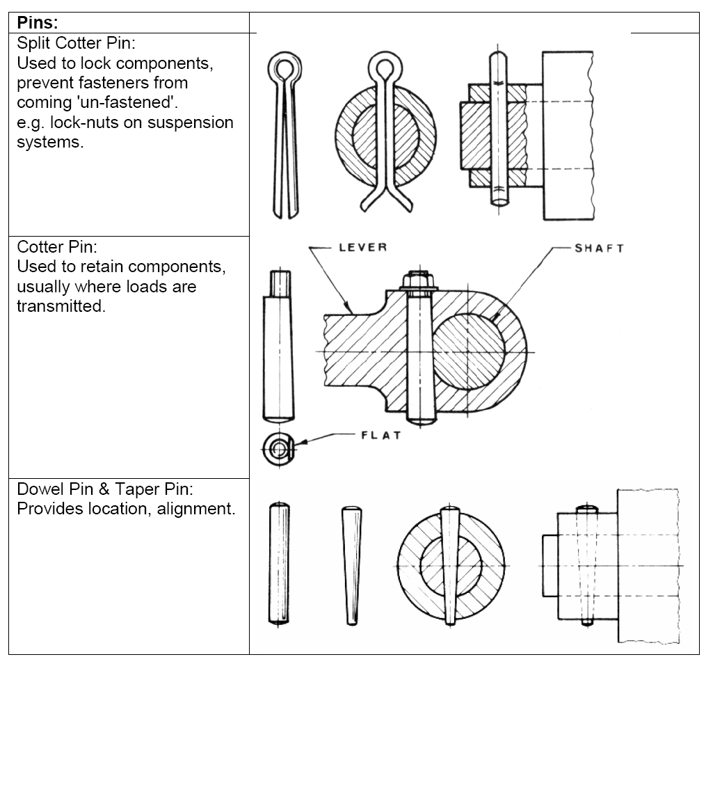

Slide 7
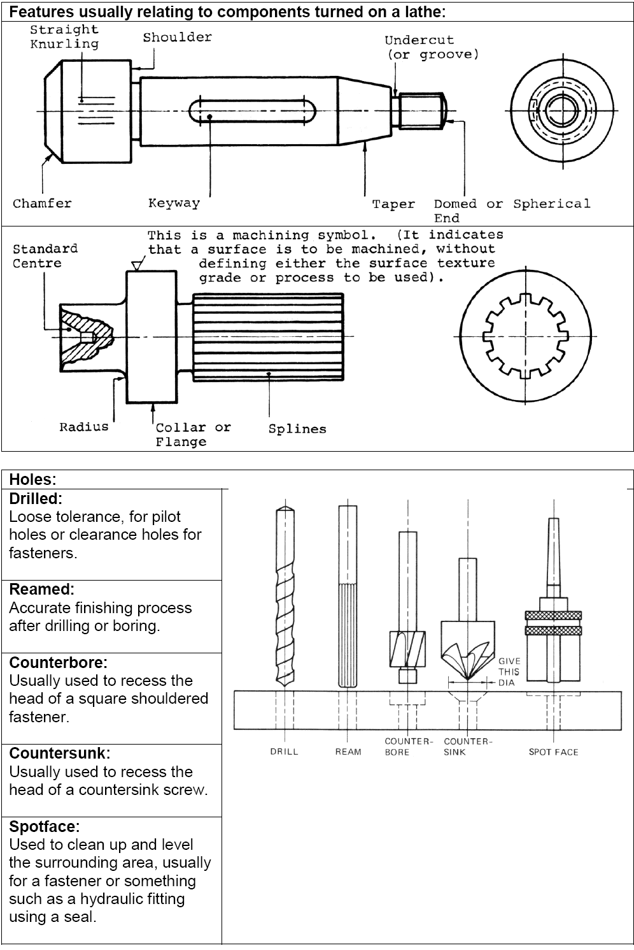

Slide 9
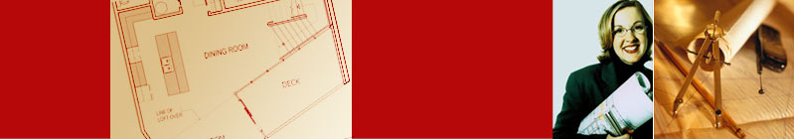

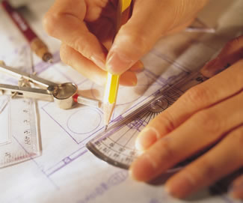
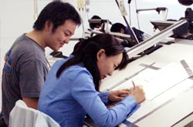
ME 142
ENGINEERING DRAWING
&
GRAPHICS
(Dimensioning)

Slide 10
LECTURE OBJECTIVES
Introduction
Dimensioning components
Dimensioning object’ s features
Placement of dimensions.

Slide 11
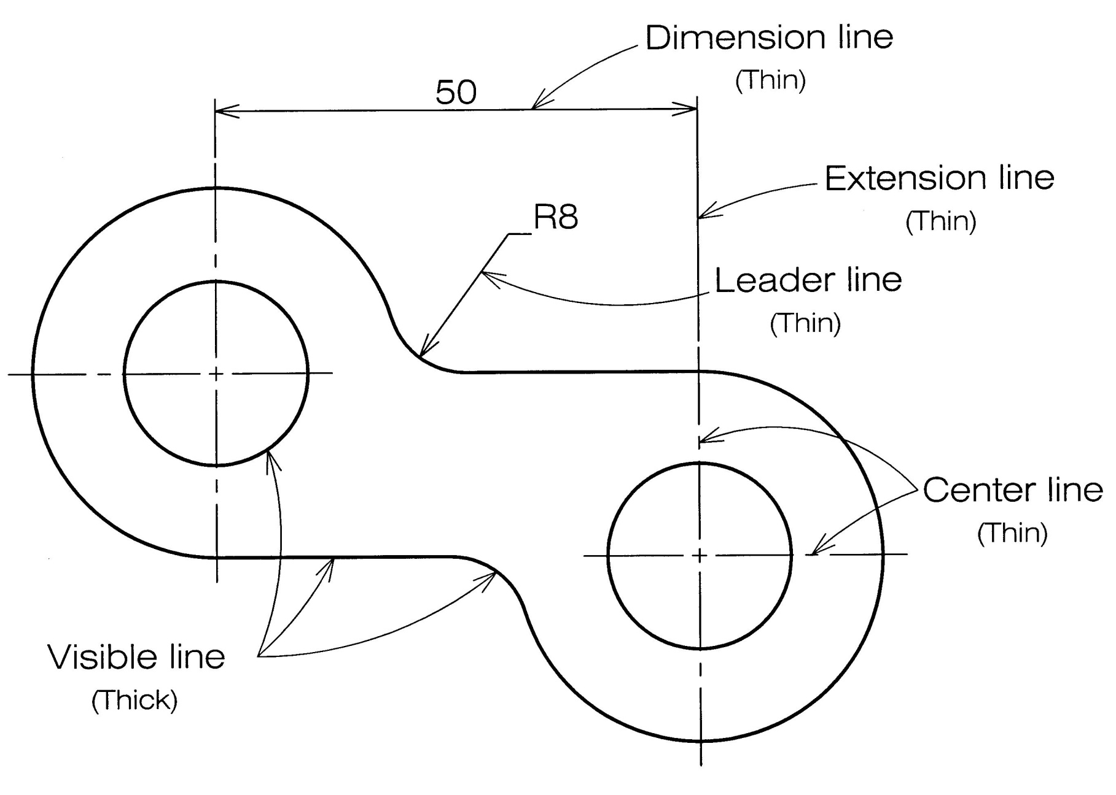
Example : Line conventions in engineering drawing

Slide 12
Meaning of Lines
Visible lines represent features that can be seen in the
current view
Hidden lines represent features that can not be seen in
the current view
Center line represents symmetry, path of motion, centers
of circles, axis of axisymmetrical parts
Dimension and Extension lines indicate the sizes and
location of features on a drawing

Slide 13
Basic Line Types
Name according
to application
Types of Lines
Appearance
Continuous thick line
Visible line
Continuous thin line
Dimension line
Extension line
Leader line
Dash thick line
Hidden line
Chain thin line
Center line

Slide 14

Introduction

Slide 15
ENGINEERING DESIGN
PROCESS
RESULT
TRANSFERRED
INFORMATION
Design
a part
Sketches
of ideas
Multiview
Drawing
Create
drawings
Shape
1. Size, Location
Dimensioning
2. Non-graphic information
Manufacture

Slide 16
DEFINITION
Dimensioning is the process of specifying part’ s
information by using of figures, symbols and notes.
This information are such as:
1. Sizes and locations of features
2. Material’s type
3. Number required
4. Kind of surface finish
5. Manufacturing process
6. Size and geometric tolerances

Slide 17
DIMENSIONING SYSTEM
1. Metric system : ISO and JIS standards
Examples
32, 32.5, 32.55, 0.5 (not .5) etc.
2. Decimal-inch system
Examples
0.25 (not .25), 5.375 etc.
3. Fractional-inch system
Examples
,
etc.

Slide 18
Dimensioning
Components

Slide 19
DIMENSIONING COMPONENTS
Extension lines
Dimension lines
(with arrowheads)
Drawn with
4H pencil
Leader lines
Dimension figures
Notes :
- local note
- general note
Lettered with
2H pencil.

Slide 20
EXTENSION LINES
indicate the location on the object’s features that are dimensioned.

Slide 21
DIMENSION LINES
indicate the direction and extent of a dimension, and inscribe dimension figures.
10
27
123º
13
43

Slide 22
LEADER LINES
indicate details of the feature with a local note.
10
27
10 Drill, 2 Holes
R16
123º
13
43

Slide 23
Recommended
Practices

Slide 24
EXTENSION LINES
Leave a visible gap (≈ 1 mm) from a view and start drawing an extension line.
Extend the lines beyond the (last) dimension line 1-2 mm.
COMMON MISTAKE
Visible gap

Slide 25
EXTENSION LINES
Do not break the lines as they cross object lines.
COMMON MISTAKE
Continuous

Slide 26
DIMENSION LINES
Dimension lines should not be spaced too close
to each other and to the view.
Leave a space at least
2 times of a letter height.
16
35
11
34
Leave a space at least
1 time of a letter height.

Slide 27
DIMENSION FIGURES
The height of figures is suggested to be 2.5~3 mm.
Place the numbers at about 1 mm above dimension
line and between extension lines.
COMMON MISTAKE
34
11
11
34

Slide 28
DIMENSION FIGURES
When there is not enough space for figure or
arrows, put it outside either of the extension lines.
Not enough space
for figures
Not enough space
for arrows
16.25
1
1
1
16.25
or

Slide 29
DIMENSION FIGURES : UNITS
The JIS and ISO standards adopt the unit of
Length dimension in millimeters without
specifying a unit symbol “mm”.
Angular dimension in degree with a symbol “º”
place behind the figures (and if necessary
minutes and seconds may be used together).

Slide 30
DIMENSION FIGURES : ORIENTATION
1. Aligned method
The dimension figures are placed so that they are readable from the bottom and right side of the drawing.
2. Unidirectional method
The dimension figures are placed so that they can be read from the bottom of the drawing.
Do not use both system on the same drawing or on the same series of drawing (JIS Z8317)

Slide 31
EXAMPLE : Dimension of length using aligned method.
30
30
30
30
30
30
30
30

Slide 32
EXAMPLE : Dimension of length using unidirectional method.
30
30
30
30
30
30
30
30

Slide 33
EXAMPLE : Dimension of angle using aligned method.
45º
45º
45º
45º
45º
45º
45º
45º

Slide 34
EXAMPLE : Dimension of angle using unidirectional method.
45º
45º
45º
45º
45º
45º
45º
45º

Slide 35
LOCAL NOTES
Place the notes near to the feature which they
apply, and should be placed outside the view.
Always read horizontally.
COMMON MISTAKE
10 Drill
10 Drill
≈ 10mm
10 Drill
Too far

Slide 36
Dimensioning
Practices

Slide 37
THE BASIC CONCEPT
Dimensioning is accomplished by adding size and location information necessary to manufacture
the object.
This information have to be
Clear
Complete
Facilitate the
- manufacturing method
measurement method

Slide 38
EXAMPLE
L
L
Designed
part
L
S
L
S
To manufacture this part
we need to know…
S
1. Width, depth and
thickness of the part.
S
2. Diameter and depth
of the hole.
“S” denotes size dimension.
“L” denotes location dimension.
3. Location of the holes.

Slide 39
ANGLE
To dimension an angle use circular dimension
line having the center at the vertex of the angle.
COMMON MISTAKE

Slide 40
ARC
Arcs are dimensioned by giving the radius, in the
views in which their true shapes appear.
The letter “R” is always lettered before the figures
to emphasize that this dimension is radius of an
arc.
R 200
R 200
or

Slide 41
ARC
The dimension figure and the arrowhead should
be inside the arc, where there is sufficient space.
Sufficient space
for both.
Sufficient space
for arrowhead only.
Insufficient space
for both.
Move figure outside
Move both figure
and arrow outside
R 62.5
R 200
R 6.5
R 58.5

Slide 42
ARC
Leader line must be radial and inclined with
an angle between 30 ~ 60 degs to the horizontal.
COMMON MISTAKE
R62.5
R62.5
R62.5
60º
R62.5
R62.5
R62.5
30º

Slide 43
ARC
Use the foreshortened radial dimension line,
when arc’ s center locates outside the sheet or
interfere with other views.
Method 1
Method 2
Drawing sheet

Slide 44
FILLETS AND ROUNDS
Give the radius of a typical fillet only by using a
local note.
If all fillets and rounds are uniform in size,
dimension may be omitted, but it is necessary to
add the note “ All fillets and round are Rxx. ”
R6.5
R12
NOTE:
All fillets and round are R6.5
NOTE:
All fillets and round are R6.5
unless otherwise specified.
Drawing sheet

Slide 45
CURVE
The curve constructed from two or more arcs,
requires the dimensions of radii and center’s
location.
COMMON MISTAKE
Tangent point

Slide 46
CYLINDER
Size dimensions are diameter and length.
Location dimension must be located from its
center lines and should be given in circular view.
Measurement
method

Slide 47
CYLINDER
Diameter should be given in a longitudinal view with the symbol “φ ” placed before the figures.
φ 100
φ 70

Slide 48
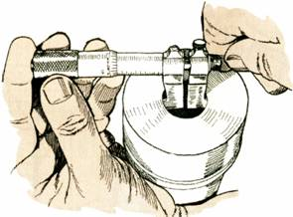
HOLES
Size dimensions are diameter and depth.
Location dimension must be located from its
center lines and should be given in circular view.
Measurement
method

Slide 49
HOLES : SMALL SIZE
Use leader line and local note to specify diameter
and hole’s depth in the circular view.
1) Through thickness hole
φ xx
φ xx Thru.
xx Drill.
xx Drill, Thru.
or
or
or

Slide 50

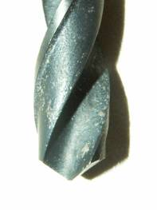
HOLES : SMALL SIZE
Use leader line and local note to specify diameter
and hole’s depth in the circular view.
2) Blind hole
φ xx, yy Deep
xx Drill, yy Deep
or
Hole’s
depth

Slide 51
HOLES : LARGE SIZE
Use extension and dimension lines
Use diametral dimension line
Use leader line and note
φ xx

Slide 52
HOLES
COMMON MISTAKE
φ xx
φ xx
φ xx
Rxx
φ xx
φ xx

Slide 53
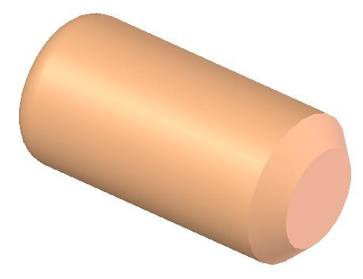
CHAMFER
Use leader line and note to indicate linear
distance and angle of the chamfer.
θ
S θ
S
For a 45º chamfer
or
CS
S S

Slide 54
ROUNDED-END SHAPES
Dimensioned according to the manufacturing
method used.
φ 12
R12
Center to Center Distance
21
5

Slide 55
ROUNDED-END SHAPES
Dimensioned according to the manufacturing
method used.
R12
12
21
Center to Center Distance
5

Slide 56
ROUNDED-END SHAPES
Dimensioned according to the manufacturing
method used.
R12
12
16
21

Slide 57
ROUNDED-END SHAPES
Dimensioned according to the manufacturing
method used.
R12
12
27
Tool cutting distance

Slide 58
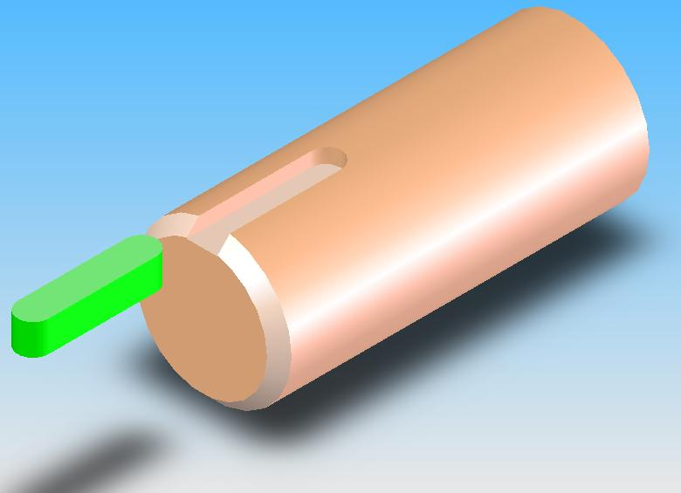
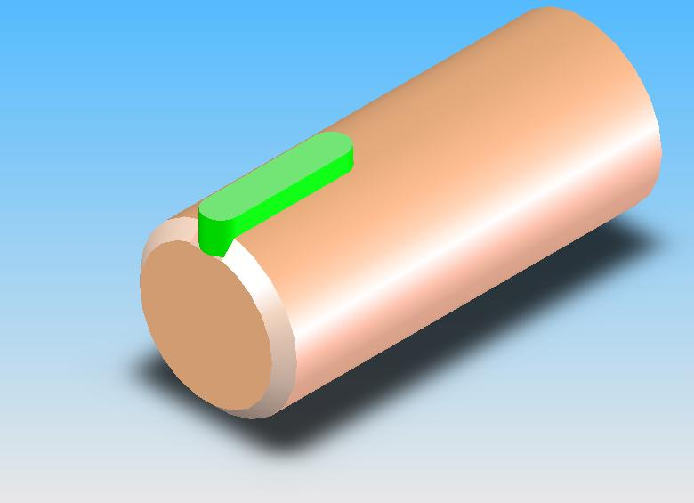
ROUNDED-END SHAPES
Dimensioned according to the standard sizes of
another part to be assembled or manufacturing
method used.
Key
(standard part)
25

Slide 59
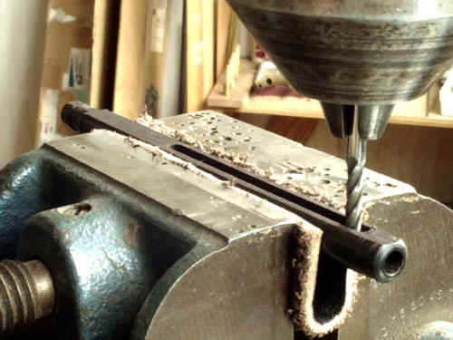
ROUNDED-END SHAPES
Dimensioned according to the standard sizes of
another part to be assembled or manufacturing
method used.
20

Slide 60
Placement of
Dimensions

Slide 61
RECOMMENDED PRACTICE
Extension lines, leader lines should not cross
dimension lines.
POOR
GOOD

Slide 62
RECOMMENDED PRACTICE
2. Extension lines should be drawn from the nearest
points to be dimensioned.
POOR
GOOD

Slide 63
RECOMMENDED PRACTICE
3. Extension lines of internal feature can cross visible
lines without leaving a gap at the intersection point.
WRONG
CORRECT

Slide 64
RECOMMENDED PRACTICE
4. Do not use object line, center line, and dimension
line as an extension lines.
POOR
GOOD

Slide 65
RECOMMENDED PRACTICE
5. Avoid dimensioning hidden lines.
POOR
GOOD

Slide 66
RECOMMENDED PRACTICE
6. Place dimensions outside the view, unless
placing them inside improve the clarity.
POOR
GOOD

Slide 67
RECOMMENDED PRACTICE
6. Place dimensions outside the view, unless
placing them inside improve the clarity.
JUST OK !!!
BETTER

Slide 68
RECOMMENDED PRACTICE
7. Apply the dimension to the view that clearly show
the shape or features of an object.
POOR
GOOD

Slide 69
RECOMMENDED PRACTICE
8. Dimension lines should be lined up and grouped
together as much as possible.
POOR
GOOD

Slide 70
RECOMMENDED PRACTICE
9. Do not repeat a dimension.
POOR
GOOD

Slide 71
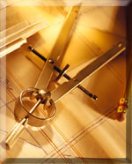
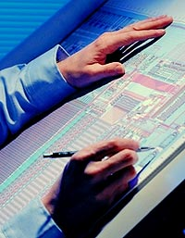
ME 142
ENGINEERING DRAWING
&
GRAPHICS
(PROJECTION METHOD)

Slide 72
LECTURE OBJECTIVES
Projection Method
Orthographic projections
Glass Box Approach
First Angle Orthographic Projection
Third Angle Orthographic Projection

Slide 73
PROJECTION METHOD
Perspective
Parallel
Oblique
Orthographic
Axonometric
Multiview

Slide 74
PROJECTION THEORY
The projection theory is used to graphically represent
3-D objects on 2-D media (paper, computer screen).
The projection theory is based on two variables:
1) Line of sight
2) Plane of projection (image plane or picture plane)

Slide 75
Line of sight is an imaginary ray of light between an
observer’s eye and an object.
There are 2 types of LOS :
parallel
and
converge
Parallel projection
Perspective projection
Line of sight
Line of sight

Slide 76
Plane of projection is an imaginary flat plane which
the image is created.
The image is produced by connecting the points where
the LOS pierce the projection plane.
Parallel projection
Perspective projection
Plane of projection
Plane of projection

Slide 77
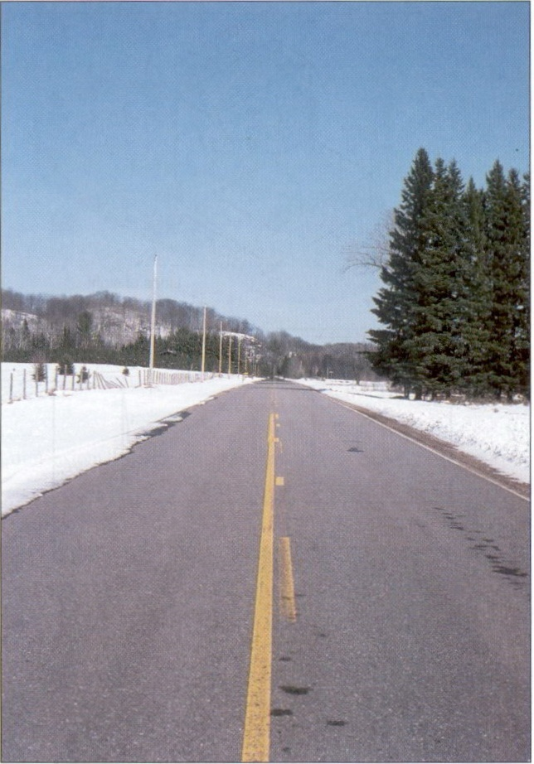
Disadvantage of
Perspective Projection
Perspective projection is not
used by engineer for manu-
facturing of parts, because
1) It is difficult to create.
2) It does not reveal exact
shape and size.
Width is distorted

Slide 78
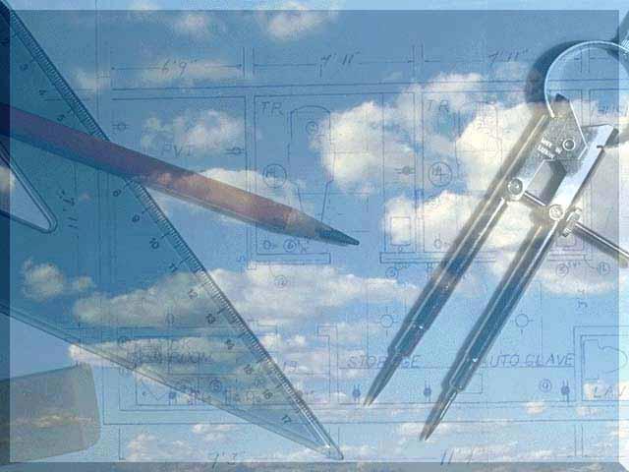
Orthographic
Projection

Slide 79
MEANING
Orthographic projection is a parallel projection technique
in which the parallel lines of sight are perpendicular to the
projection plane
Object views from top
1
2
1
5
2
3
4
5
3
4
Projection plane

Slide 80
ORTHOGRAPHIC VIEW
Orthographic view depends on relative position of the object
to the line of sight.
Rotate
Two dimensions of an
object is shown.
Tilt
More than one view is needed
to represent the object.
Multiview drawing
Three dimensions of an object is shown.
Axonometric drawing

Slide 81
ORTHOGRAPHIC VIEW
NOTES
Orthographic projection technique can produce either
1. Multiview drawing
that each view show an object in two dimensions.
2. Axonometric drawing
that show all three dimensions of an object in one view.
Both drawing types are used in technical drawing for communication.

Slide 82
Axonometric (Isometric) Drawing
Advantage
Easy to understand
Disadvantage
Shape and angle distortion
Example
Distortions of shape and size in isometric drawing
Circular hole becomes ellipse.
Right angle becomes obtuse angle.

Slide 83
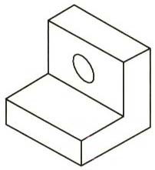
Multiview Drawing
Advantage
It represents accurate shape and size.
Disadvantage
Require practice in writing and reading.
Example
Multiviews drawing (2-view drawing)

Slide 84
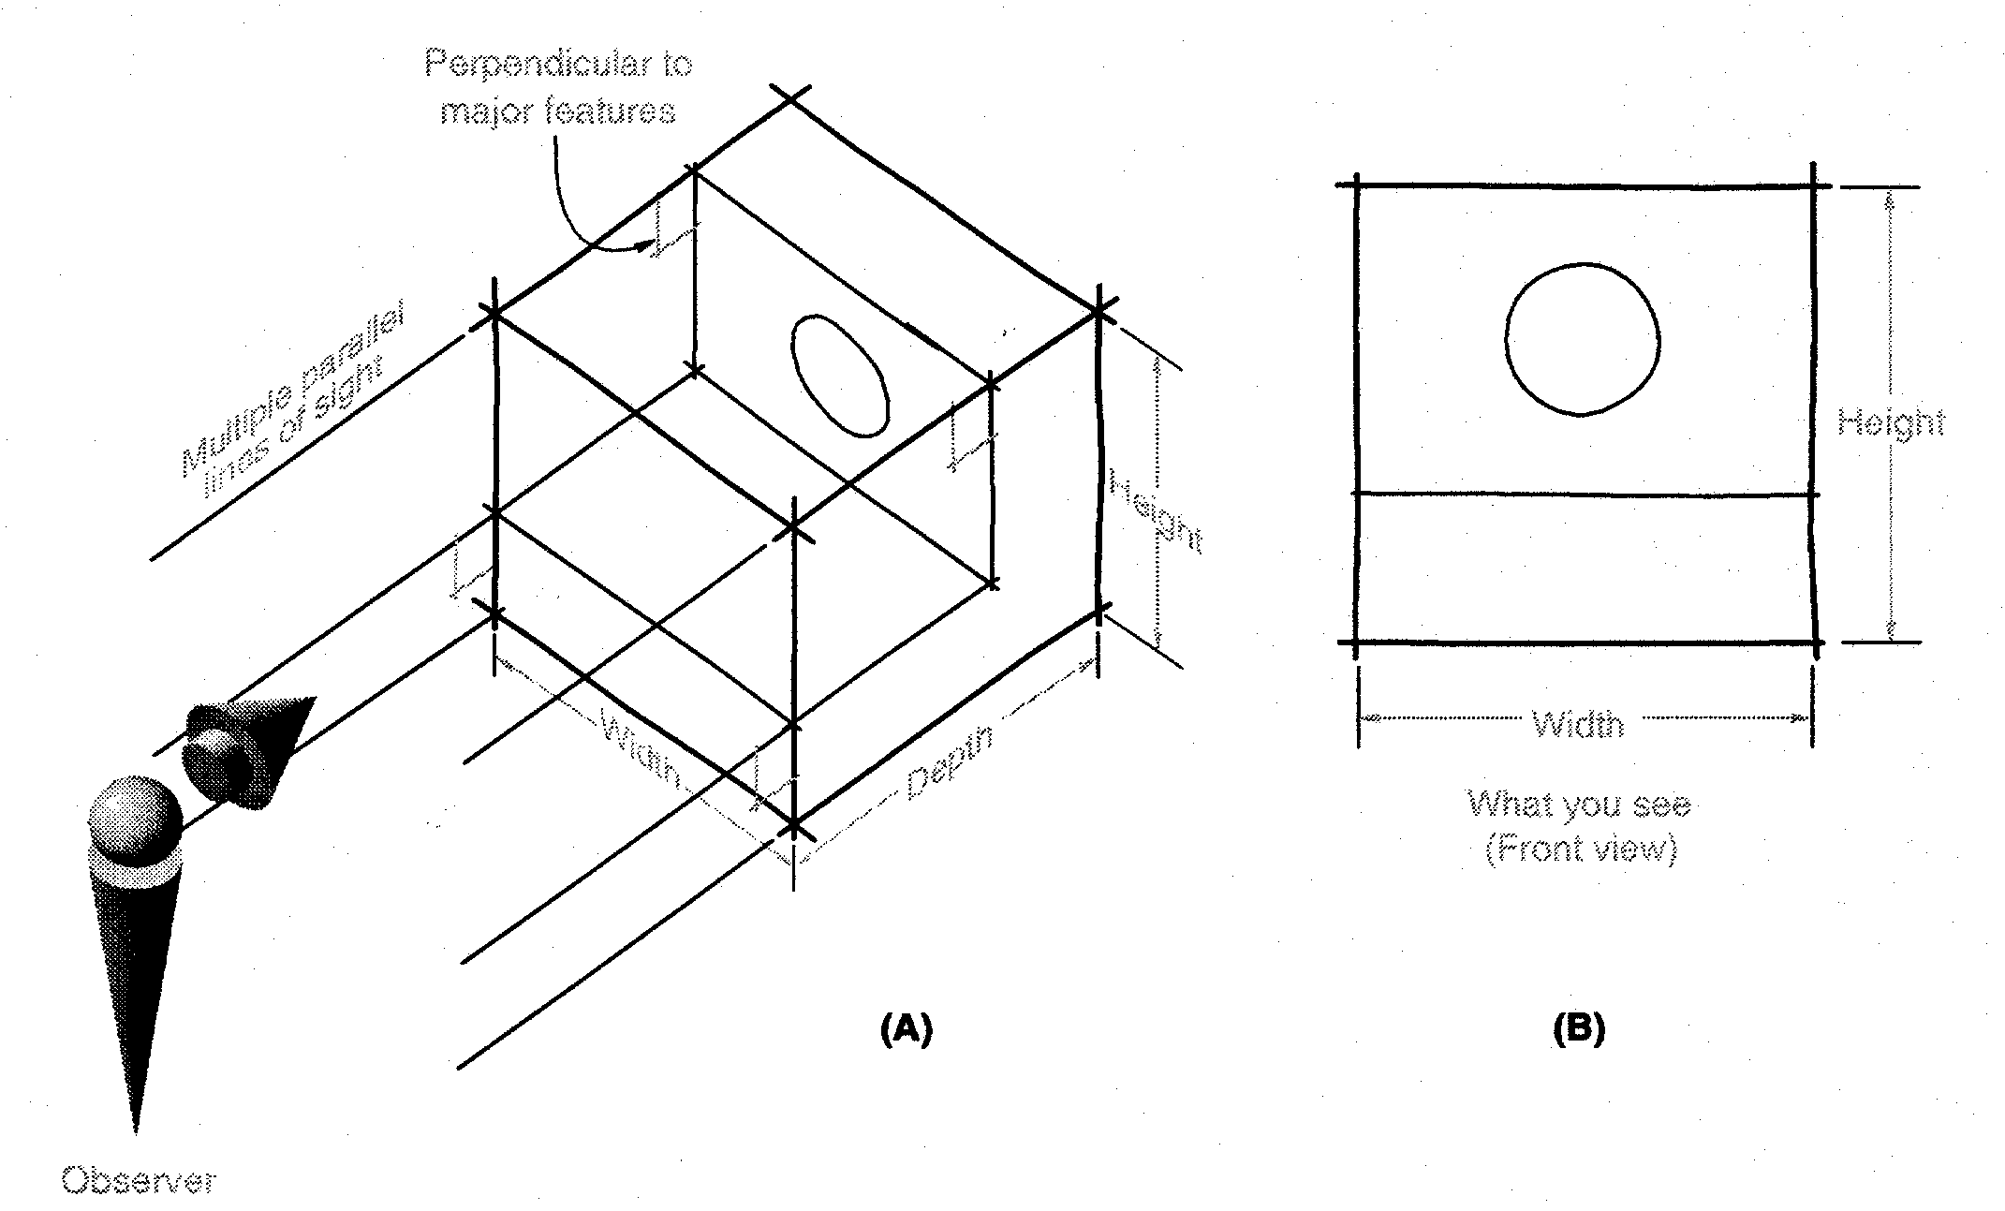
Orthographic Projections
Orthographic Projections are a collection of 2-D drawings that work together to give an accurate overall representation of an object.
Notes:
By definition for each element of a orthographic projection drawing you only present 2 of the three dimensions. Think of it as an observer look at one face, what do they see.
Any orthographic projection drawing normal has three views… Front view, Top view and side view (Right or left side view)

Slide 85
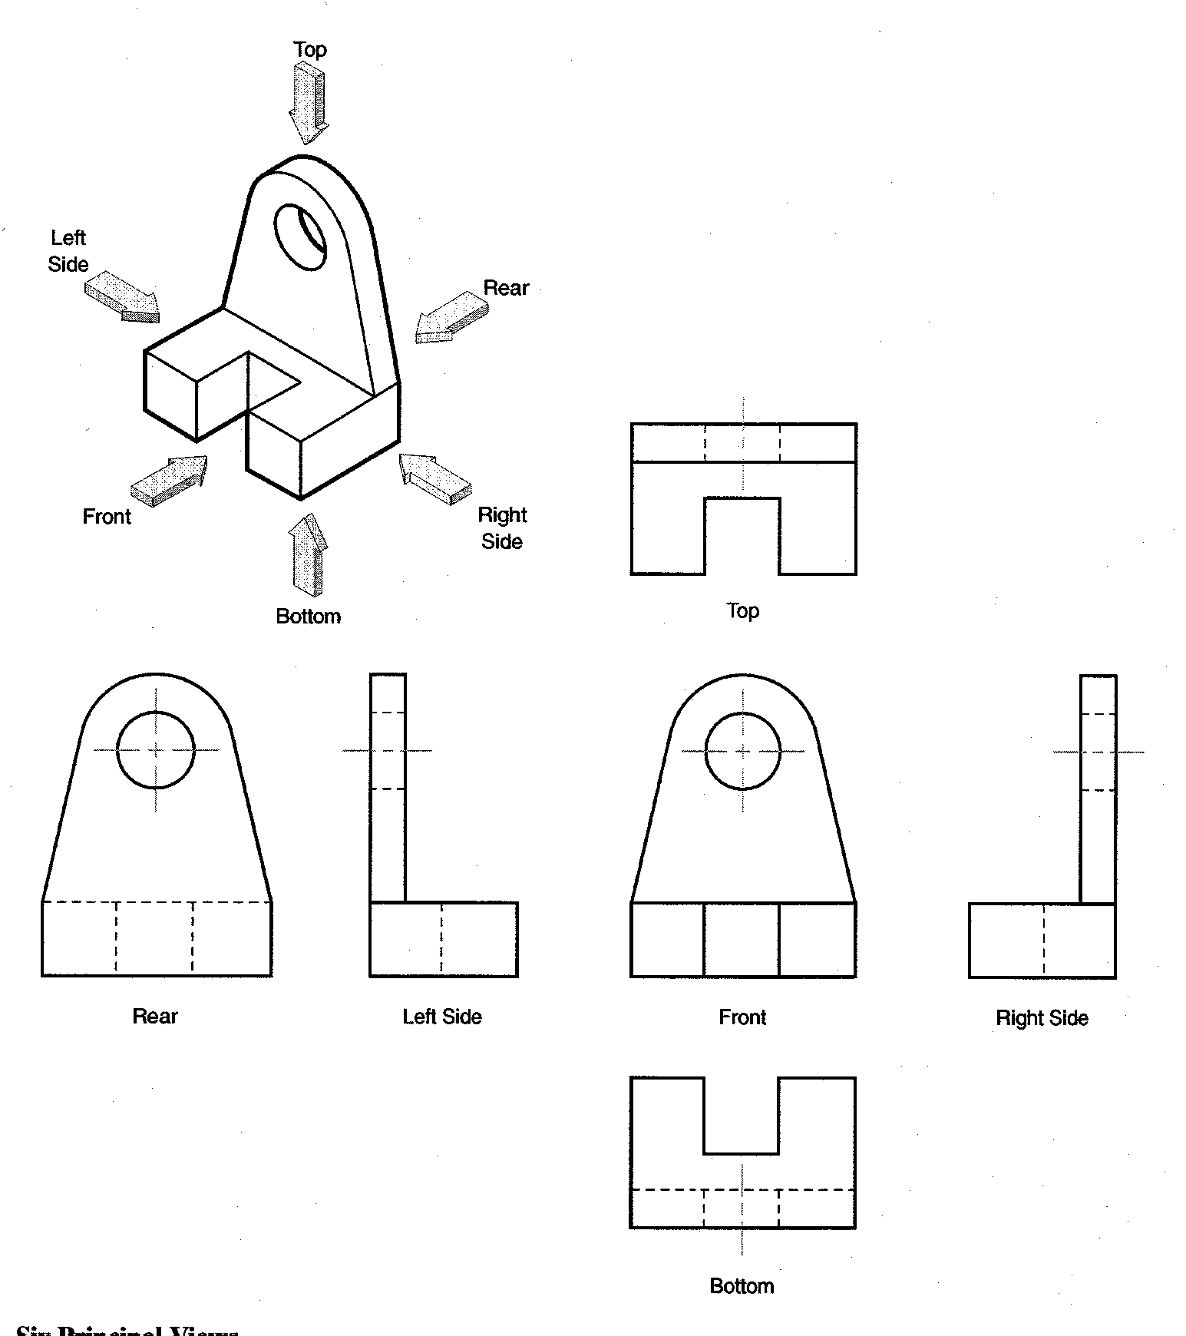
Defining the Six Principal Views or Orthographic Views
Notes:
Although any face could be chosen to be the front, once front and two other face are selected all are determined. There are really SIX PRINICPAL VIEWS as defined in the diagram.
Generally do not need all six to fully describe the object. A conventional Engineering Drawing will normally have 2 to 3 views unless it required more views to describe the geometry/ profile.
We know which ones they are on the drawing, because we always present them in the same relationship to each other. I.e. Top above front, right to right of front, etc. This convention is called as the Third angle method.. The other method in which the views can be placed is the First angle method in which the Top view is below front view, Right side view is on left side of front view. For this class we will be following the Third angle convention.
These are often called orthographic projections – because the line of sight is perpendicular to the principal view

Slide 86
Which Views to Present?
General Guidelines
Pick a Front View that is most descriptive of object
Normally the longest dimension is chosen as the width (or depth)
Most common combination of views is to use:
  Front, Top, and Side View
Notes:
Pick the views which will help in describing the object with highest clarity.
Explain what is an auxiliary view. Explain that they are drawn to show specific features that are not clear in the Principal views.

Slide 87
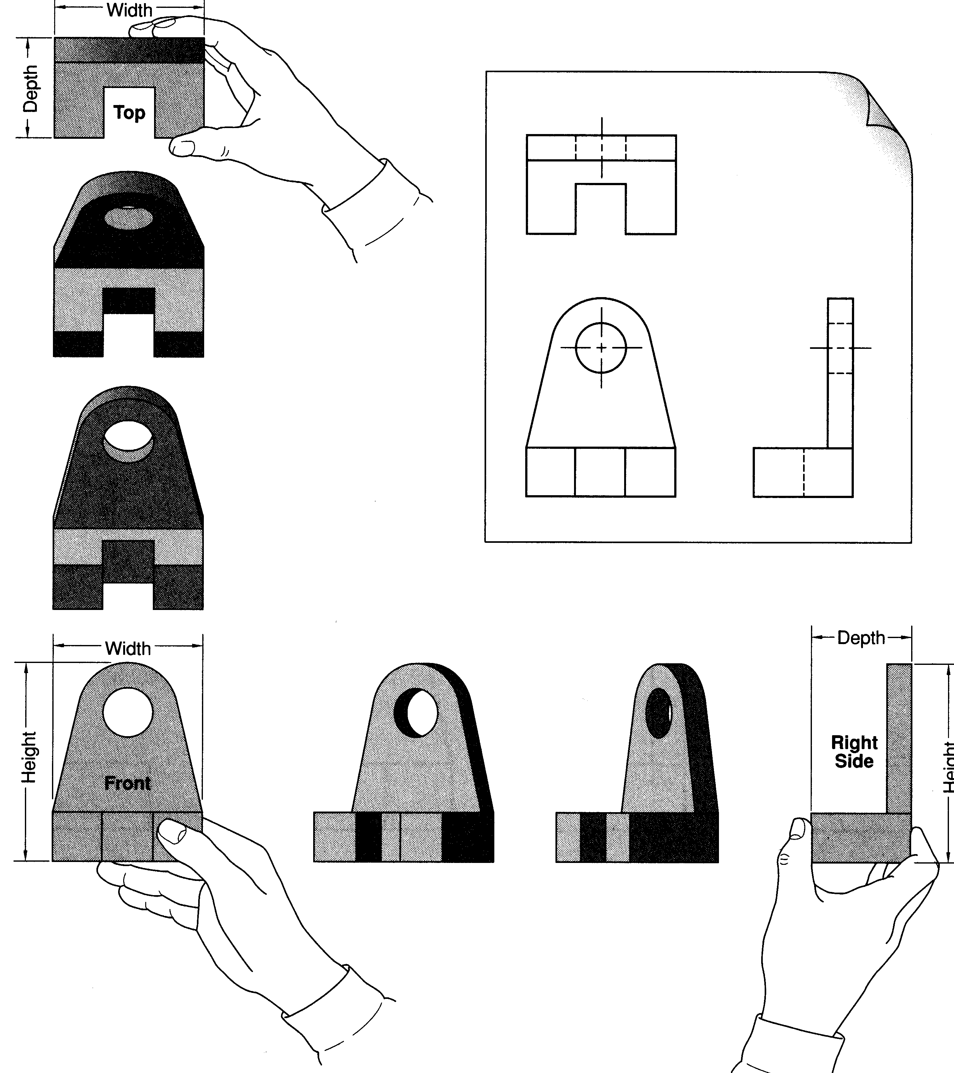
Notes:
The Idea is to have them take an object from the table.
Declare front. FRONT View is the MOST DESCRIPTIVE VIEW OF THE OBJECT. The view that gives MORE INFORMATION ABOUT THE OBJECT.
Rotate 90 degrees “up” to get top view.
Rotate Back.
Rotate 90 degrees clockwise to get right side.
This give three principal views commonly used.

Slide 88
Glass Box Approach
Place the object in a glass box
Freeze the view from each direction (each of the six sides of the box) and unfold the box
Notes:
At this point, give an introduction to Glass-box approach for developing orthographic projection drawings.
Student slides contain snapshots of the animation

Slide 89
Glass Box Approach
Notes:
The object, whose orthographic projection needs to be drawn, is enclosed in a glass-box

Slide 90
Glass Box Approach
Notes:
Project points on the right view of the glass-box, just as done for front and top

Slide 91
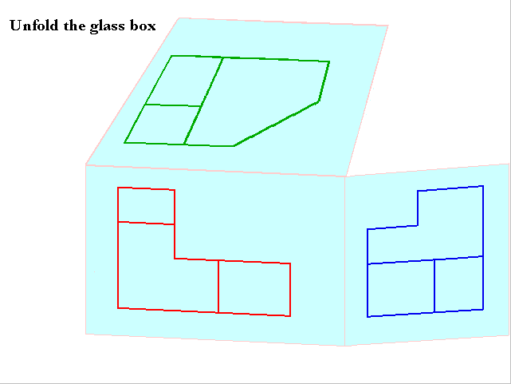
Glass Box Approach
Notes:
Unfold the glass box, see how the views align

Slide 92
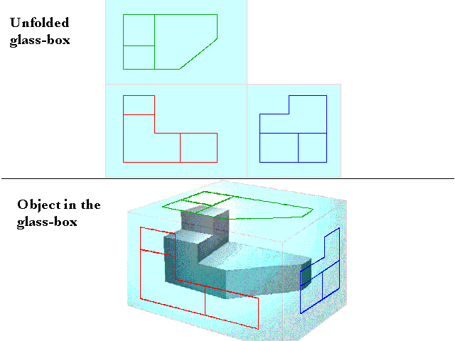
Glass Box Approach
Notes:
Unfold the glass box, see how the views align

Slide 93
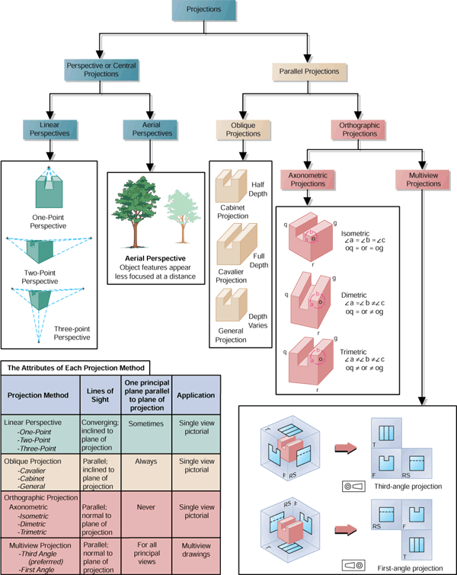
First and Third Angle Projections
Third-angle Projection
First-angle Projection
First Angle
Third Angle
Notes:
Instructor:
Third angle projection is normally used in the US while Europe uses the First Angle projection. Note the symbols at the bottom of each one which tell you which projection that you are viewing.
These can be confusing to students. We are only highlighting the fact that there are different ways to represent projections. It is not expected for students to fully understand the differences.
From Fundamentals of Graphic Communications by Bertoline, McGraw-Hill

Slide 94
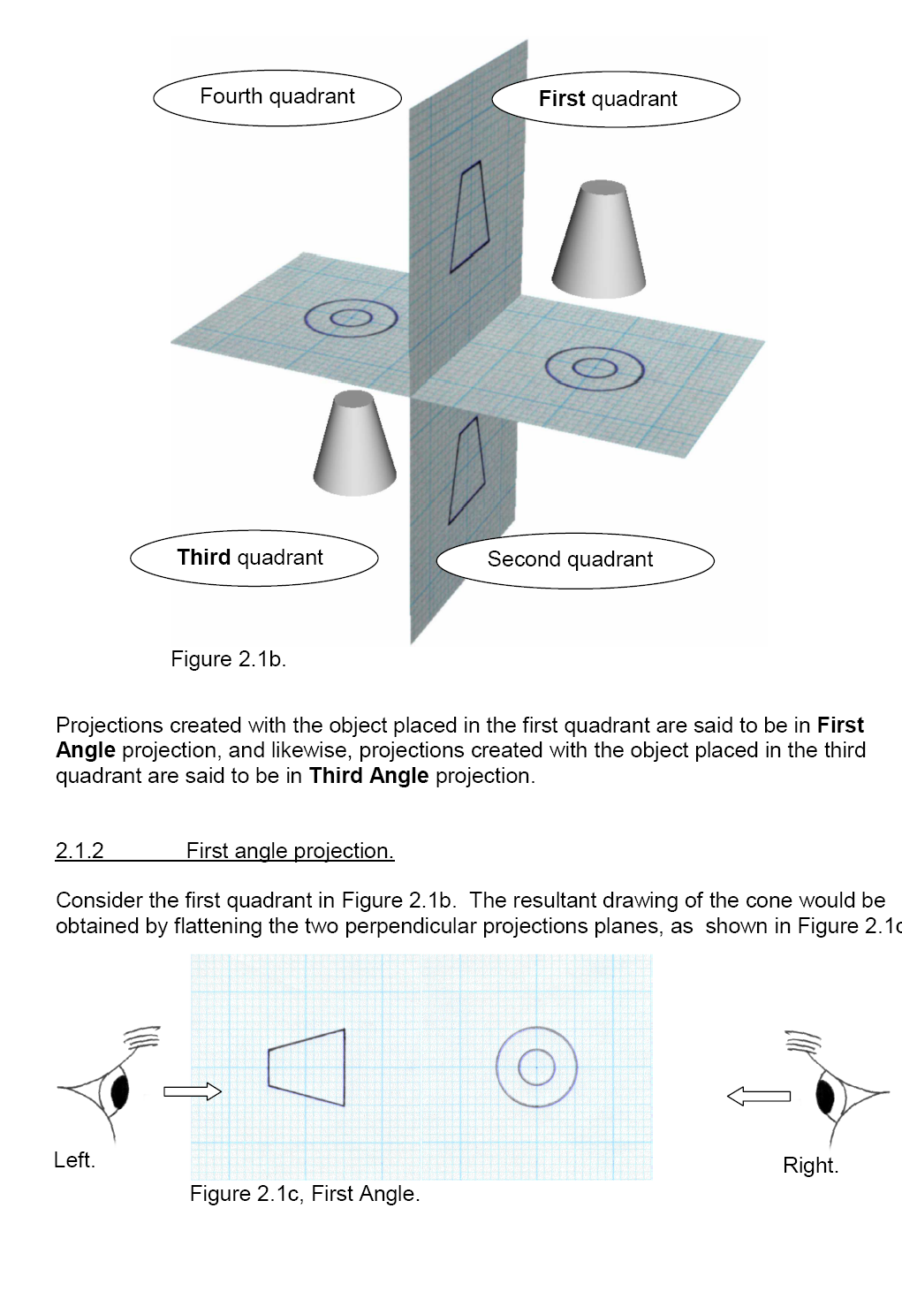

Slide 96
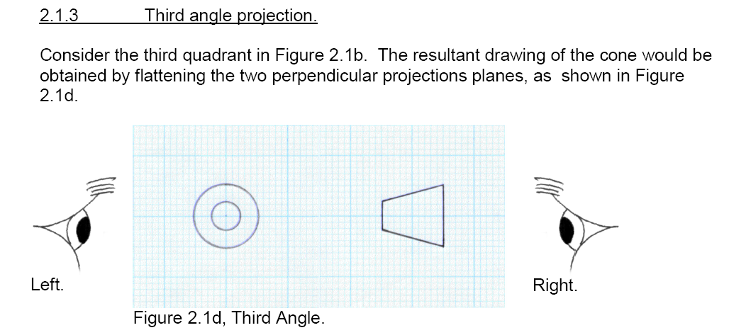

Slide 97
ME 142
ENGINEERING DRAWING
&
GRAPHICS
(Lettering)
ABCDEFGHIJKLMNOPQRSTUVWXYZABCDEFGHIJKLMNOPQRSTUVWXYZABCDEF

Slide 98
Text on Drawings
Text on engineering drawing is used :
To communicate nongraphic information.
As a substitute for graphic information, in those instance where text can communicate the needed information more clearly and quickly.
Thus, it must be written with
Legibility
- shape
- space between letters and words
Uniformity
- size
- line thickness

Slide 99
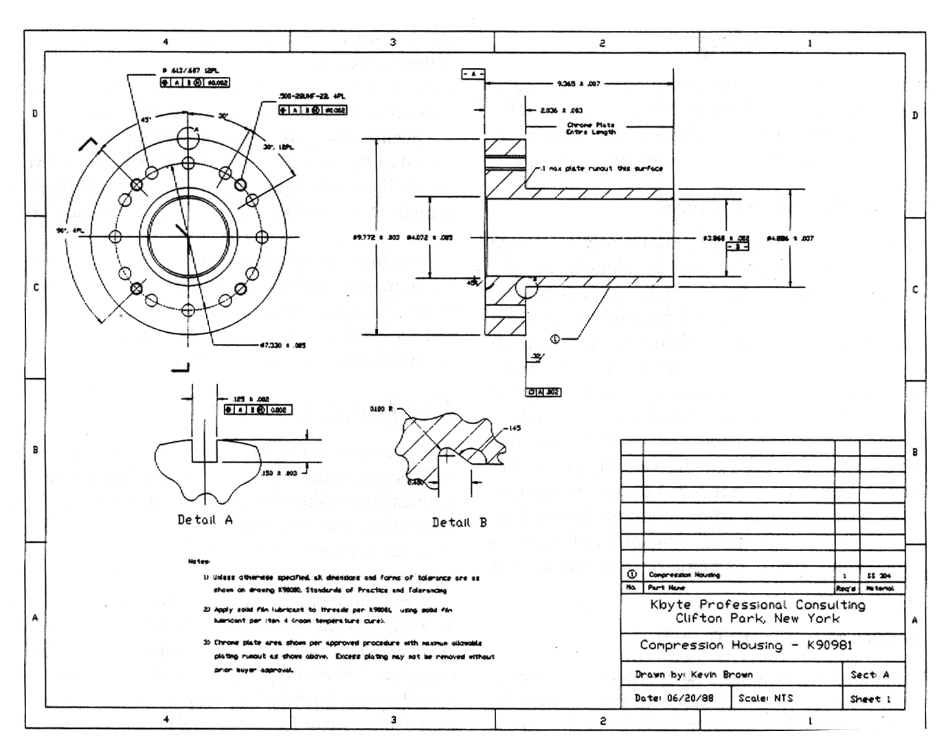
Example
Placement of the text on drawing
Dimension & Notes
Notes
Title Block

Slide 100
Lettering Standard
ANSI Standard
This course
Use a Gothic text style,
either inclined or vertical.
Use only a vertical Gothic
text style.
Use all capital letters.
Use both capital and
lower-case letters.
Use 3 mm for most
text height.
Same. For letters in title block it is recommend to use 5~8 mm text height
Space between lines
of text is at least 1/3
of text height.
N/A.
Follows ANSI rule.

Slide 101
Basic Strokes
Straight
Slanted
Horizontal
Curved
Examples : Application of basic stroke
4
5
“I” letter
1
“A” letter
1
2
“B” letter
1
3
6
3
2

Slide 102
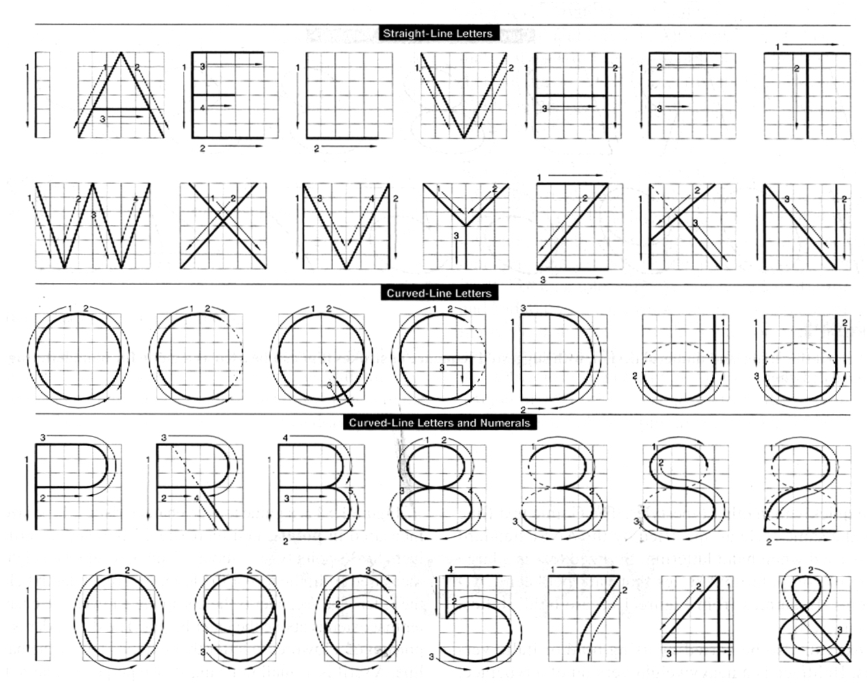
Suggested Strokes Sequence
Upper-case letters & Numerals
Straight line
letters
Curved line
letters
Curved line
letters &
Numerals

Slide 103
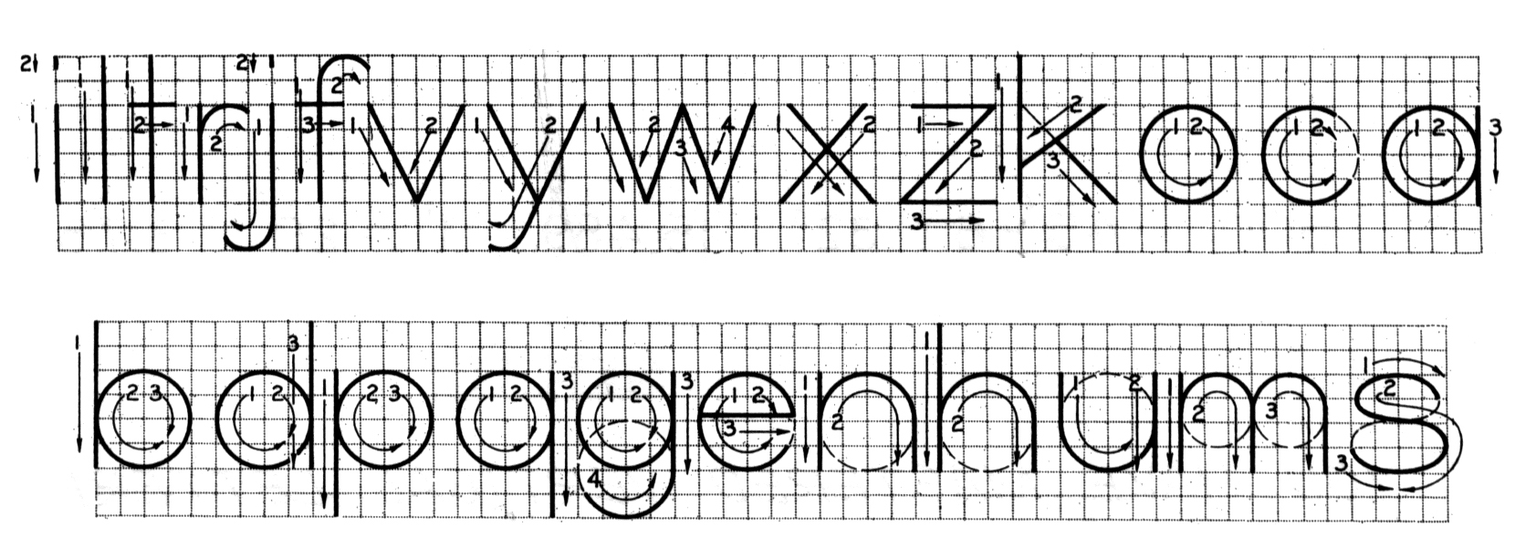
Suggested Strokes Sequence
Lower-case letters
The text’ s body height is about 2/3 the height of a capital
letter.

Slide 104
Stroke Sequence
I
L
T
F
E
H

Slide 105
Stroke Sequence
V
X
W

Slide 106
Stroke Sequence
N
M
K
Z
Y
A
4

Slide 107
Stroke Sequence
O
Q
C
G

Slide 108
Stroke Sequence
D
U
P
B
R
J
1
2

Slide 109
Stroke Sequence
5
7

Slide 110
Stroke Sequence
S
0
3
6
8
9

Slide 111
Stroke Sequence
l
i

Slide 112
Stroke Sequence
v
w
x
k
z

Slide 113
Stroke Sequence
j
y
f
t
r

Slide 114
Stroke Sequence
c
o
a
b
d
p
q
e

Slide 115
Stroke Sequence
g
n
m
h
u
s

Slide 116
Word Composition
Look at the same word having different spacing between letters.
A) Non-uniform spacing
JIRAPONG
B) Uniform spacing
J
I
R
A
P
O
N
G
Which one is easier to read ?

Slide 117
Word Composition
JIRAPONG
Spacing
|
\ /
|
|
|
|
|
|
\
)(
)
(
Contour
General conclusions are:
Space between the letters depends on the contour of
the letters at an adjacent side.
Good spacing creates approximately equal background
area between letters.

Slide 118
Space between Letters
1. Straight - Straight
3. Straight - Slant
2. Straight - Curve
4. Curve - Curve

Slide 119
Space between Letters
5. Curve - Slant
6. Slant - Slant
7. The letter “L” and “T”
≡
slant
slant
≡
slant
straight

Slide 120
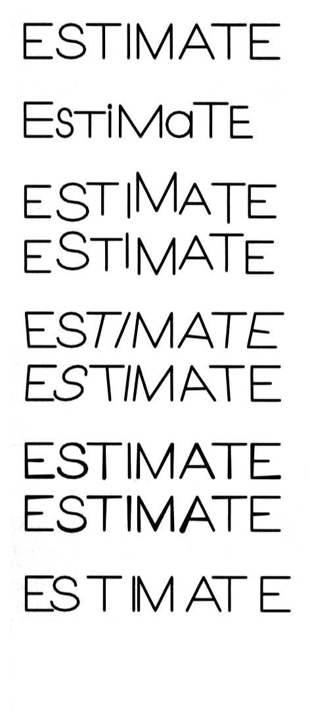
Example : Good and Poor Lettering
GOOD
Not uniform in style.
Not uniform in height.
Not uniformly vertical or inclined.
Not uniform in thickness of stroke.
Area between letters not uniform.
Area between words not uniform.

Slide 121
Sentence Composition
Leave the space between words equal to the space
requires for writing a letter “O”.
Example
ALL
O
DIMENSIONS
O
ARE
O
IN
MILLIMETERS
O
UNLESS
OTHERWISE
O
SPECIFIED.

Slide 122
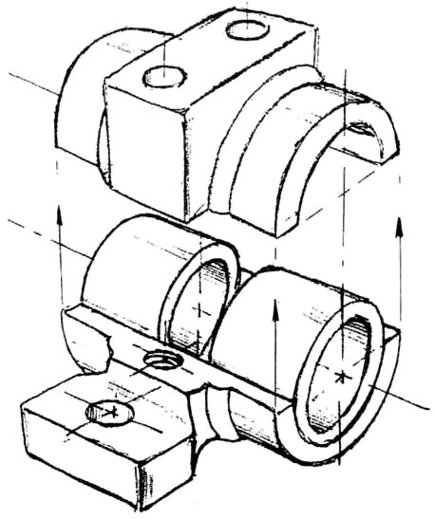
ME 142
ENGINEERING DRAWING
&
GRAPHICS
(Freehand Sketching)

Slide 123
Straight Line
1. Hold the pencil naturally.
2. Spot the beginning and end points.
3. Swing the pencil back and forth between the points, barely
touching the paper until the direction is clearly established.
4. Draw the line firmly with a free and easy wrist-and-arm
motion

Slide 124
Horizontal line
Vertical line

Slide 125
Nearly vertical
inclined line
Nearly horizontal
inclined line

Slide 126
Small Circle
Method 1 : Starting with a square
1. Lightly sketching the square and marking the mid-points.
2. Draw light diagonals and mark the estimated radius.
3. Draw the circle through the eight points.
Step 1
Step 2
Step 3

Slide 127
Small Circle
Method 2 : Starting with center line
1. Lightly draw a center line.
2. Add light radial lines and mark the estimated radius.
3. Sketch the full circle.
Step 1
Step 2
Step 3

Slide 128
Large Circle
Place the little finger (or pencil’ s tip) at the center as a pivot, and set the pencil point at the radius-distance from the center.
Hold the hand in this position and rotate the paper.

Slide 129
Arc
Method 1 : Starting with a square
Method 2 : Starting with a center line

Slide 130
Steps in Sketching
1. Block in main shape.
2. Locate the features.
3. Sketch arcs and circles.
4. Sketch lines.

Slide 131
Example

